Slide 1

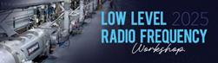
Compensating for Amplifier Non-Linearity in a SEL Controller
October 14th, 2025
Shrividhyaa Sankar Raman
Engineer

Slide 2
Outline
Introduction
SEL Architecture
Linear Fit
Limits
Observing Non-Linearity
Affine Fit
Piecewise Linear Fit
Conclusion

Slide 3
Introduction
Solid State Amplifiers (SSAs) play a crucial role in powering superconducting RF cavities.
Their performance directly impacts cavity field stability and gradient control.
Accurate calibration is essential for computable amplifier output for SEL operation.
This presentation focuses on non-linearity observed in one of the PIP-II amplifiers at the HB650 Test Stand and on how to compensate for it.

Slide 4
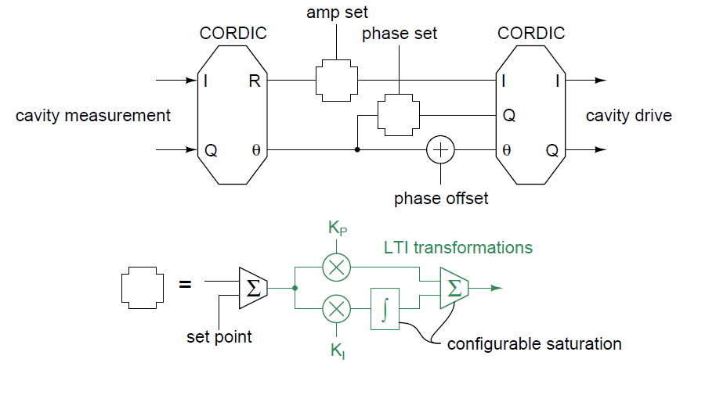
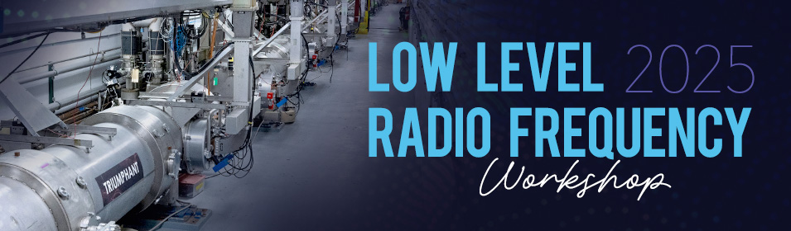
SEL Architecture and Need for Limits
First CORDIC converts the I/Q signals into magnitude and phase for amplitude and phase feedback loops.
Feedback outputs are interpreted as I/Q signals.
Second CORDIC rotates these I/Q signals by the cavity phase + offset, forming positive feedback for self-oscillation.
On resonance, the phase loop set point is near zero, corresponding to acceleration on crest.
The forward I/Q drive signals coming out of the second CORDIC, with configurable saturation enforcing safe operating limits.

Slide 5
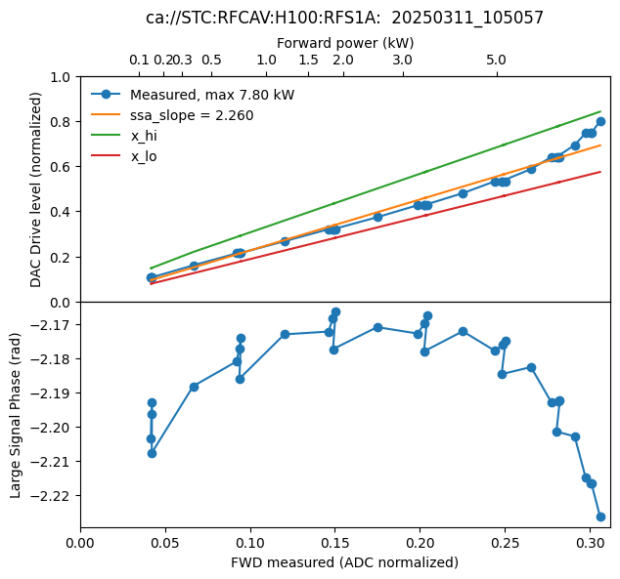
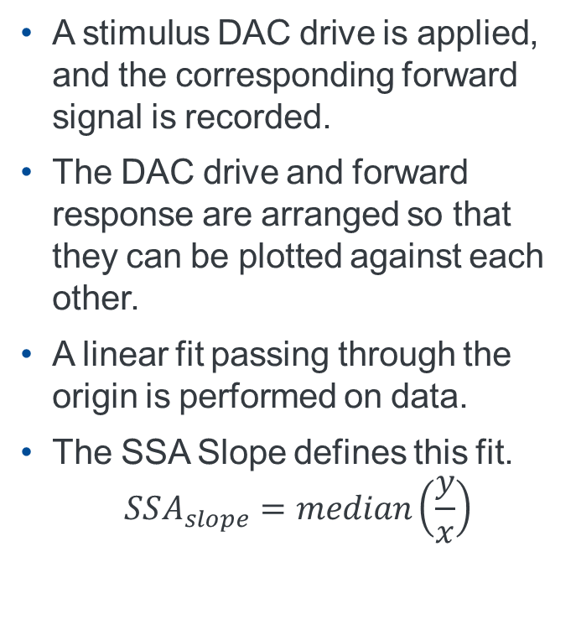
Linear Fit Modeling
A stimulus DAC drive is applied, and the corresponding forward signal is recorded.
The DAC drive and forward response are arranged so that they can be plotted against each other.
A linear fit passing through the origin is performed on data.
The SSA Slope defines this fit. $SSA_{slope}=median\left(\frac{y}{x}\right)$

Slide 6
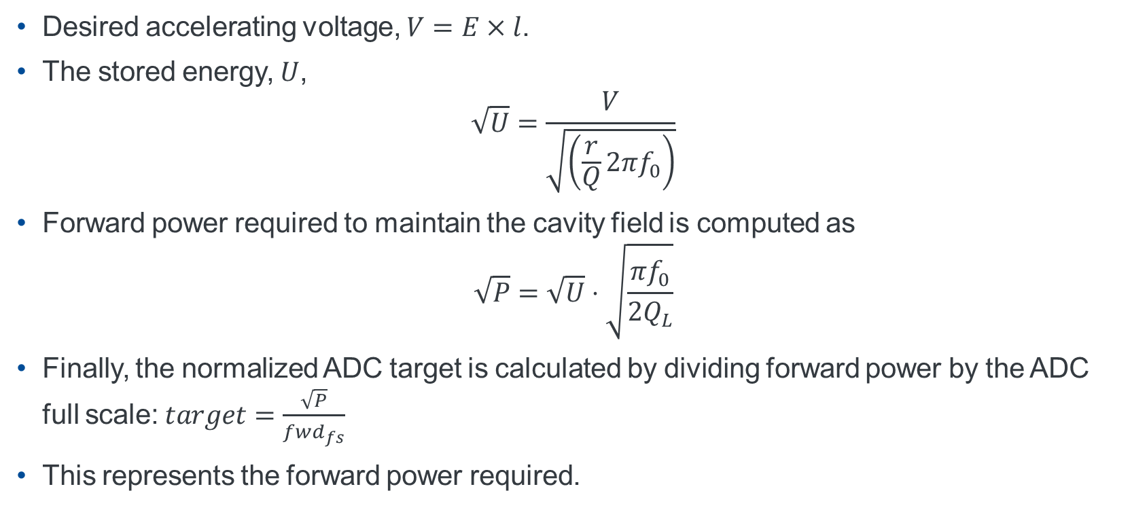
Determining Amplifier Drive
Desired accelerating voltage, $V=E×l$.
The stored energy, $U$, $\sqrt{U}=\frac{V}{\sqrt{\left(\frac{r}{Q}2πf_{0}\right)}}$
Forward power required to maintain the cavity field is computed as $\sqrt{P}=\sqrt{U}⋅\sqrt{\frac{πf_{0}}{2Q_{L}}}$
Finally, the normalized ADC target is calculated by dividing forward power by the ADC full scale: $target=\frac{\sqrt{P}}{fwd_{fs}}$
This represents the forward power required.

Slide 7
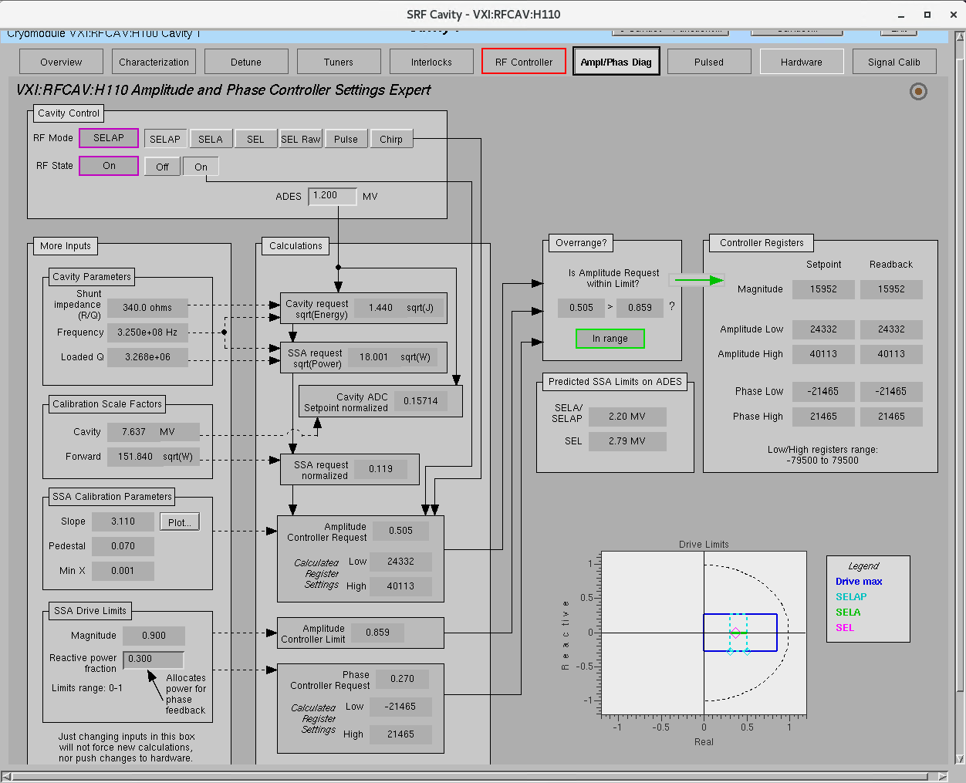
Amplitude/Phase Diagnostic page that represents this Calculation

Slide 8
SEL Modes
The Self-Excited Loop (SEL) controller supports 4 operating modes for flexibility and stability: SEL Raw, SEL, SELA and SELAP.
SEL Raw operates with drive amplitude specified as a percentage of full scale, primarily for early testing before full calibration.
SEL follows the cavity resonance without amplitude or phase stabilization, providing basic feedback.
SELA adds amplitude regulation while tracking the cavity’s natural resonant frequency.
SELAP includes both amplitude and phase locking, GDR behavior within locking limits.

Slide 9
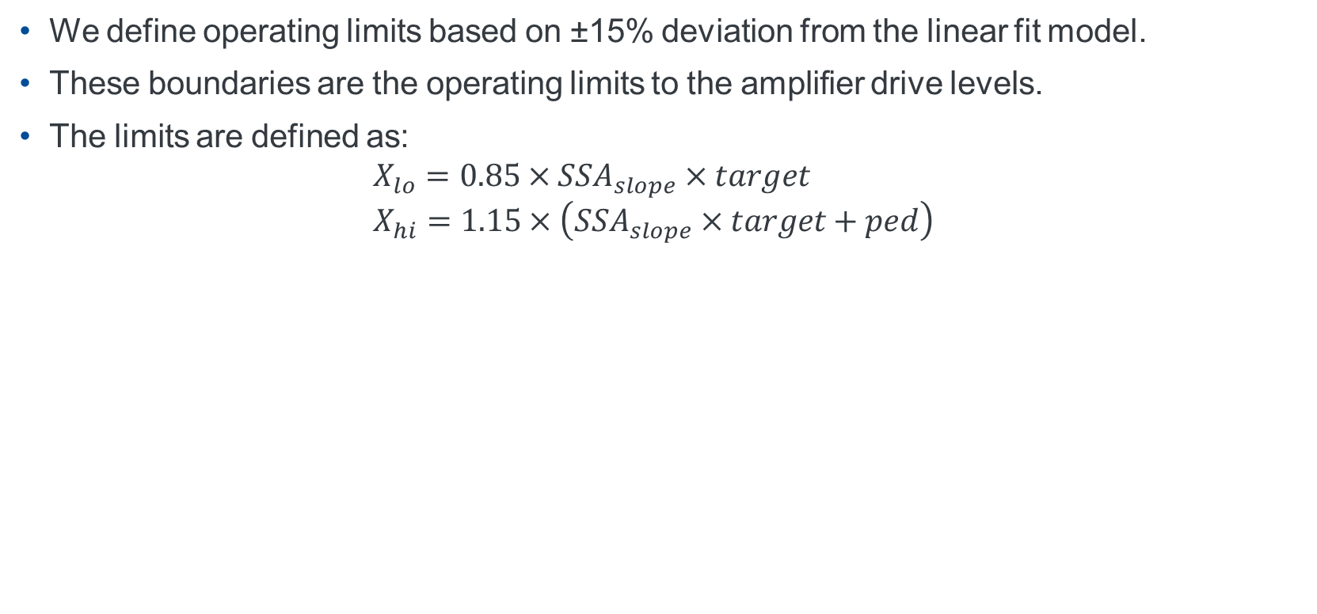
Amplitude Limits
We define operating limits based on ±15% deviation from the linear fit model.
These boundaries are the operating limits to the amplifier drive levels.
The limits are defined as: $X_{lo}=0.85×SSA_{slope}×target$ $X_{hi}=1.15×\left(SSA_{slope}×target+ped\right)$

Slide 10
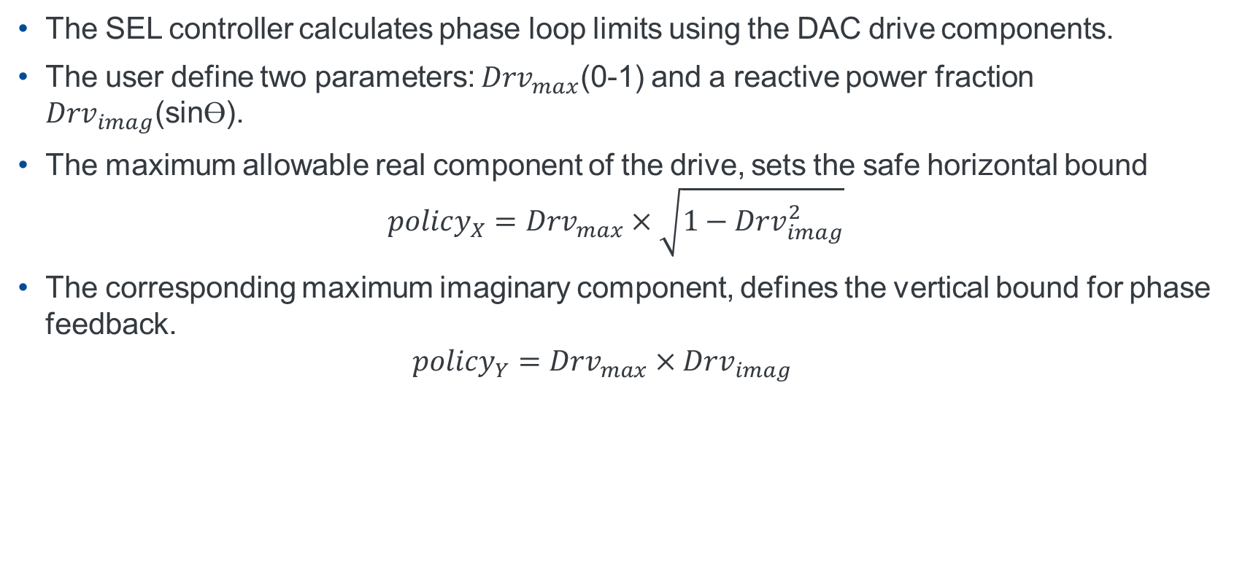
Phase Limits
The SEL controller calculates phase loop limits using the DAC drive components.
The user define two parameters: $Drv_{max}$(0-1) and a reactive power fraction $Drv_{imag}$(sinӨ).
The maximum allowable real component of the drive, sets the safe horizontal bound $policy_{X}=Drv_{max}×\sqrt{1−Drv_{imag}^{2}}$
The corresponding maximum imaginary component, defines the vertical bound for phase feedback. $policy_{Y}=Drv_{max}×Drv_{imag}$

Slide 11
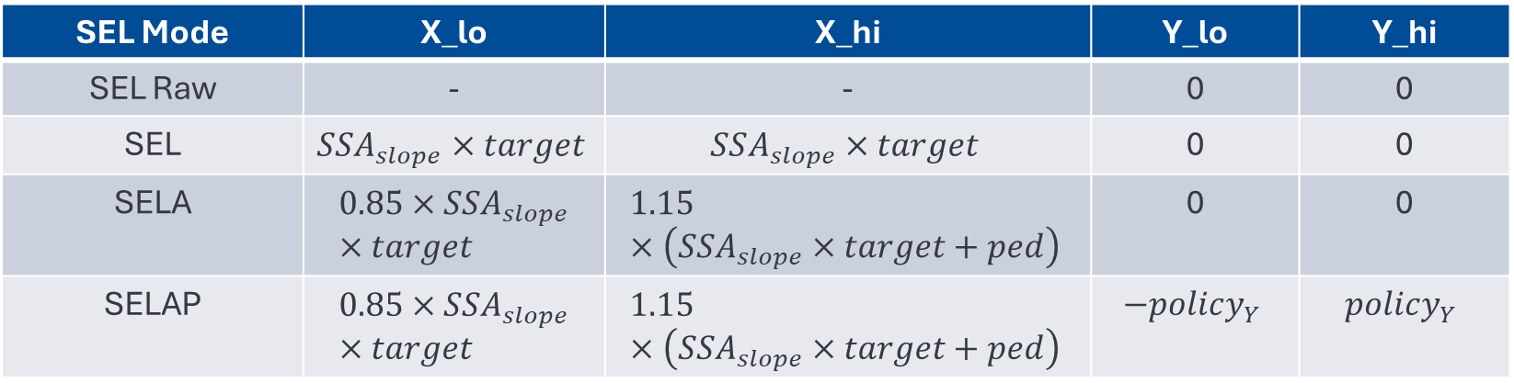
SEL Modes Operating Limits
Each SEL mode applies specific bounds to the I/Q drive coordinates to ensure safe operation.
SEL Mode | X_lo | X_hi | Y_lo | Y_hi
SEL Raw | - | - | 0 | 0
SEL | $$SSA_{slope}×target$$ | $$SSA_{slope}×target$$ | 0 | 0
SELA | $$0.85×SSA_{slope}×target$$ | $$1.15×\left(SSA_{slope}×target+ped\right)$$ | 0 | 0
SELAP | $$0.85×SSA_{slope}×target$$ | $$1.15×\left(SSA_{slope}×target+ped\right)$$ | $$−policy_{Y}$$ | $$policy_{Y}$$

Slide 12
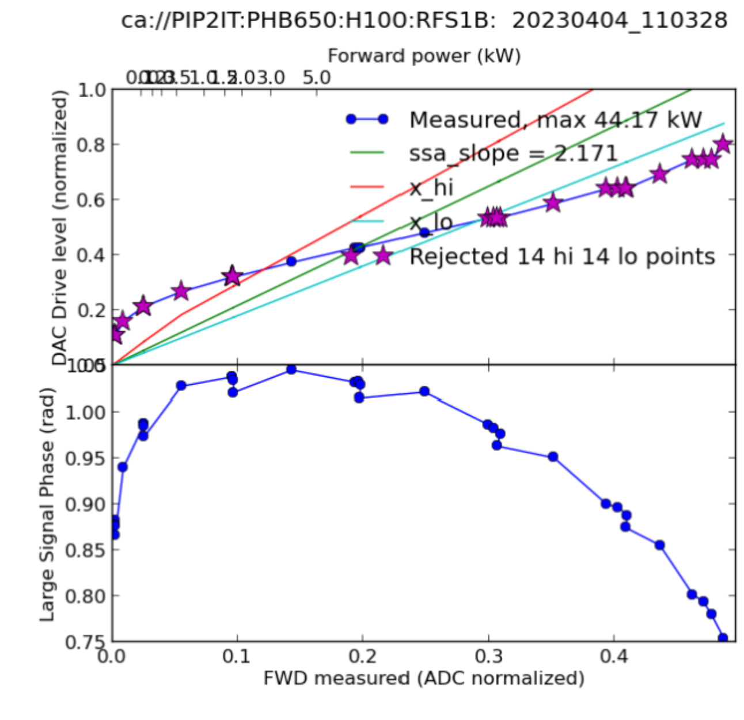
Observing Non-Linearity
At the PIP-II HB650 Test Stand, we observed deviations from the linear model.
These deviations indicate that amplifier response does not always scale proportionally with input drive.
This non-linearity causes the calibration to fail because most of the points fall outside the normal linear fit and range.
Data recorded at the test stand helps to evaluate and compensate for this situation.

Slide 13
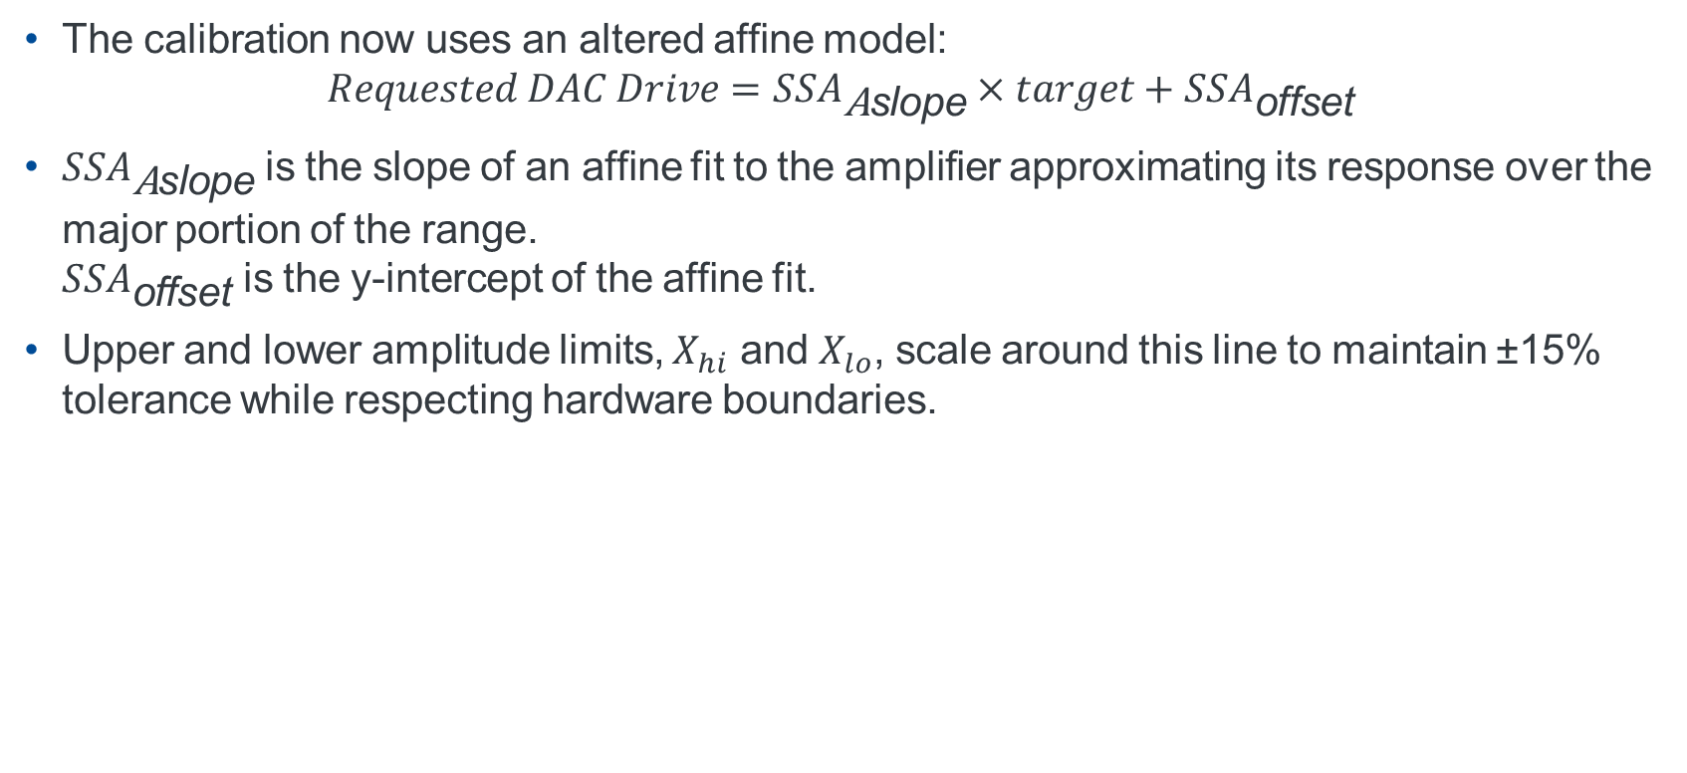
Operating Limits for Non-Linear Characteristics
The calibration now uses an altered affine model: $Requested DAC Drive=SSA_{\text{A}\text{s}\text{lope}}×target+SSA_{\text{o}\text{ffset}}$
$SSA_{\text{A}\text{slope}}$ is the slope of an affine fit to the amplifier approximating its response over the major portion of the range. $SSA_{\text{offset}}$ is the y-intercept of the affine fit.
Upper and lower amplitude limits, $X_{hi}$ and $X_{lo}$, scale around this line to maintain ±15% tolerance while respecting hardware boundaries.

Slide 14
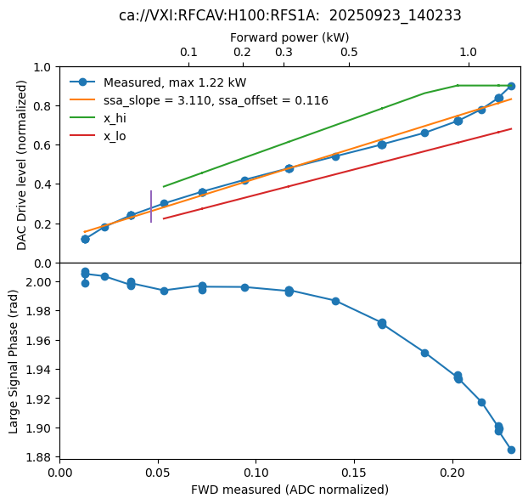
SSA Calibration fit for a Non-Linear fit

Slide 15
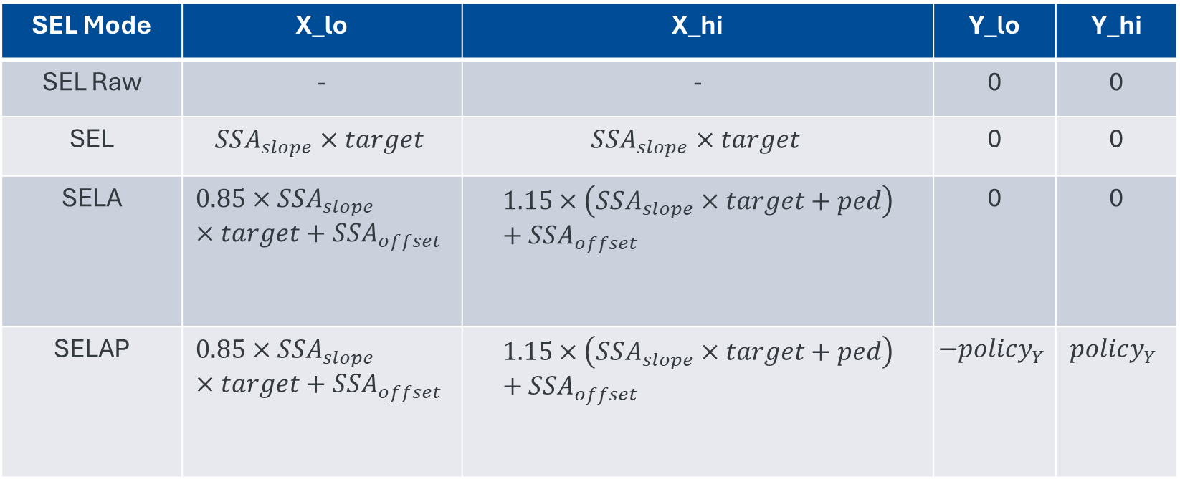
Updated SEL Modes Operating Limits
SEL Mode | X_lo | X_hi | Y_lo | Y_hi
SEL Raw | - | - | 0 | 0
SEL | $$SSA_{slope}×target$$ | $$SSA_{slope}×target$$ | 0 | 0
SELA | $$0.85×SSA_{slope}×target+SSA_{offset}$$ | $$1.15×\left(SSA_{slope}×target+ped\right)+SSA_{offset}$$ | 0 | 0
SELAP | $$0.85×SSA_{slope}×target+SSA_{offset}$$ | $$1.15×\left(SSA_{slope}×target+ped\right)+SSA_{offset}$$ | $$−policy_{Y}$$ | $$policy_{Y}$$

Slide 16
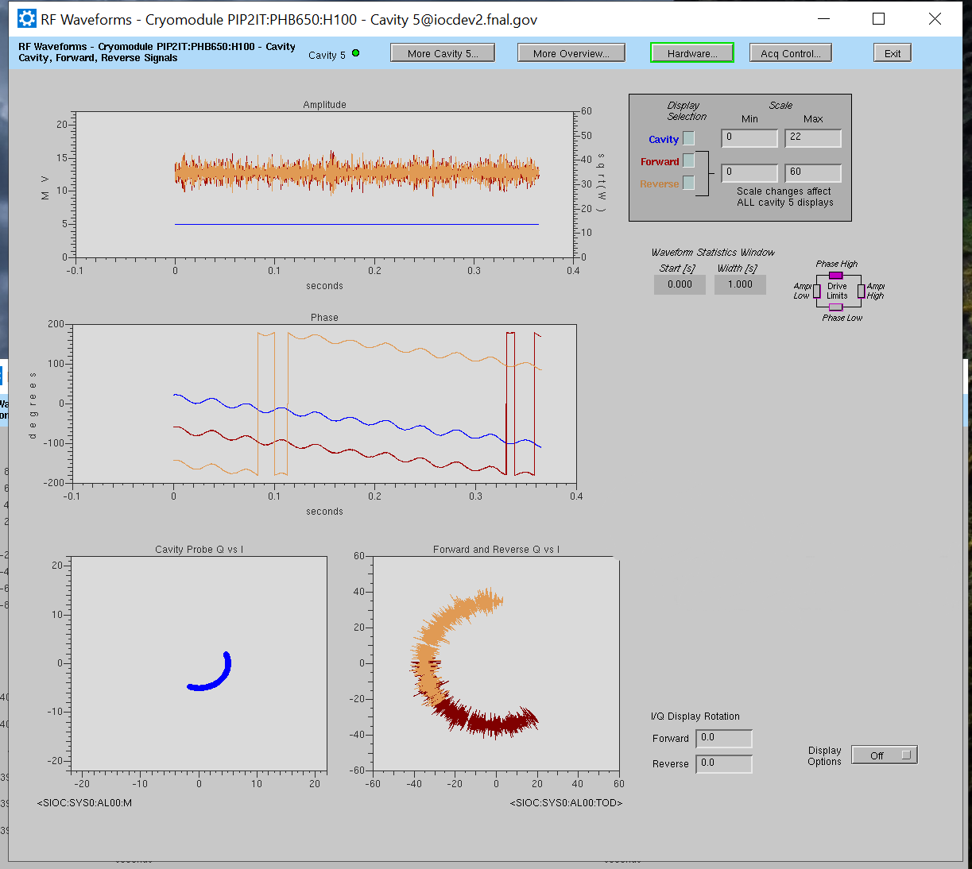
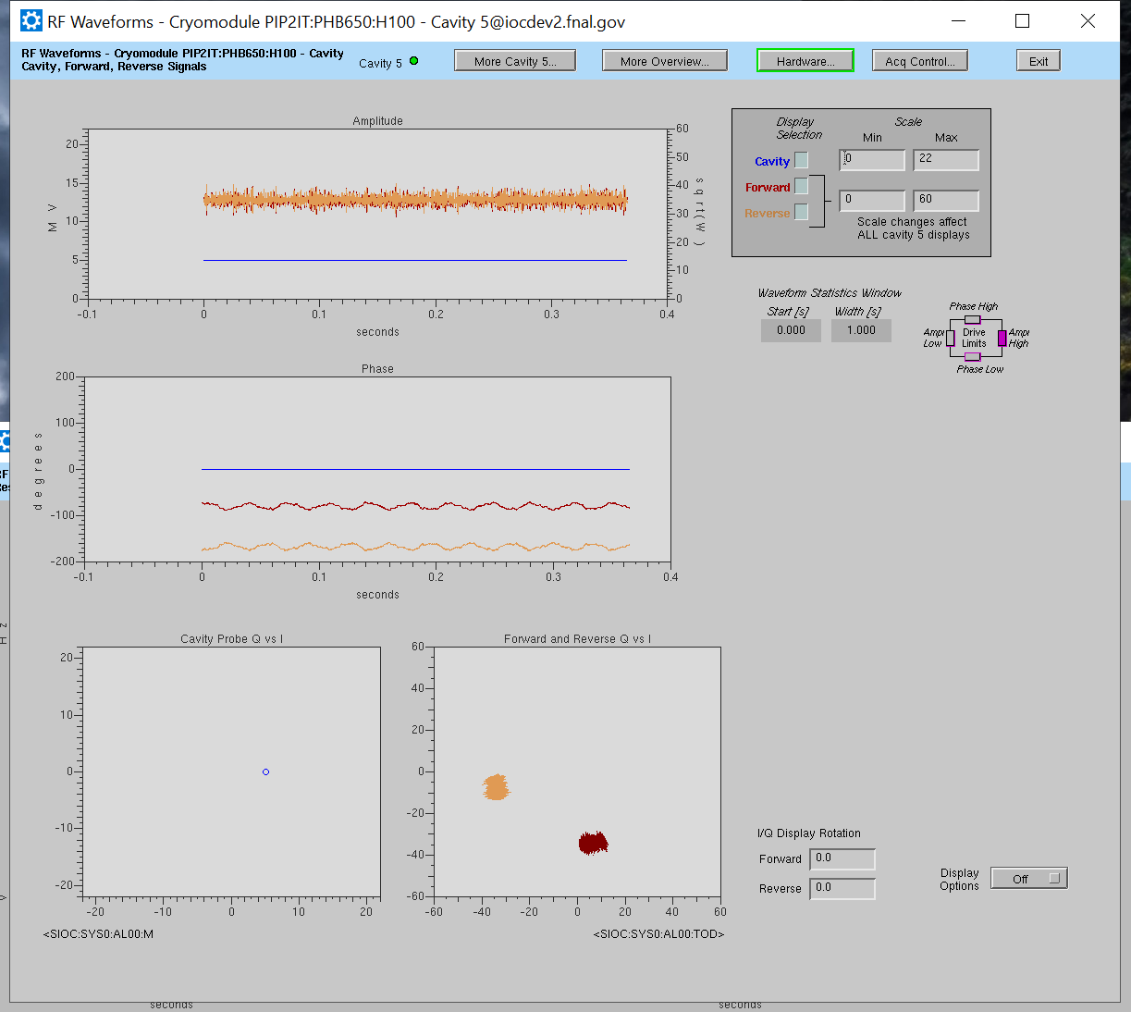
SELA and SELAP Modes
SELA Mode
SELAP Mode

Slide 17
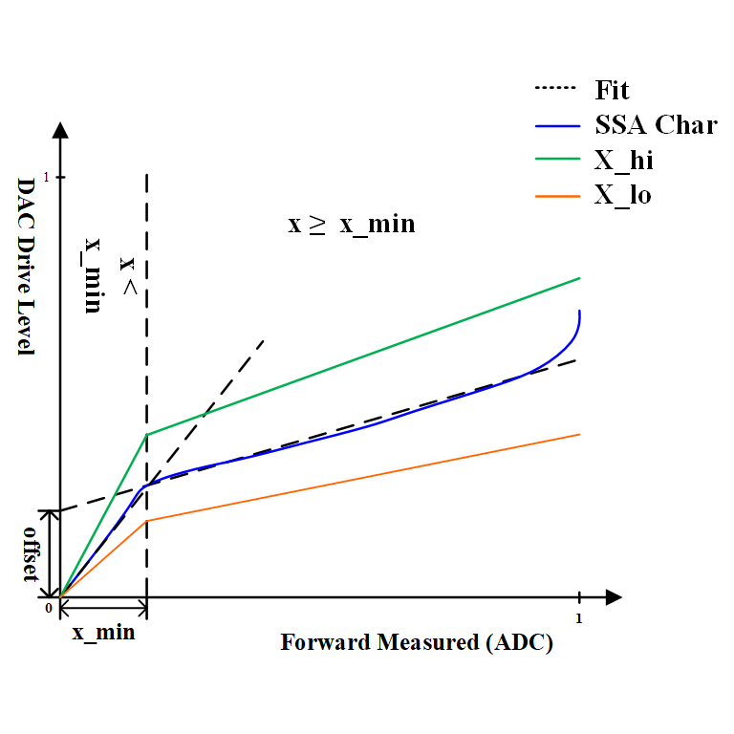
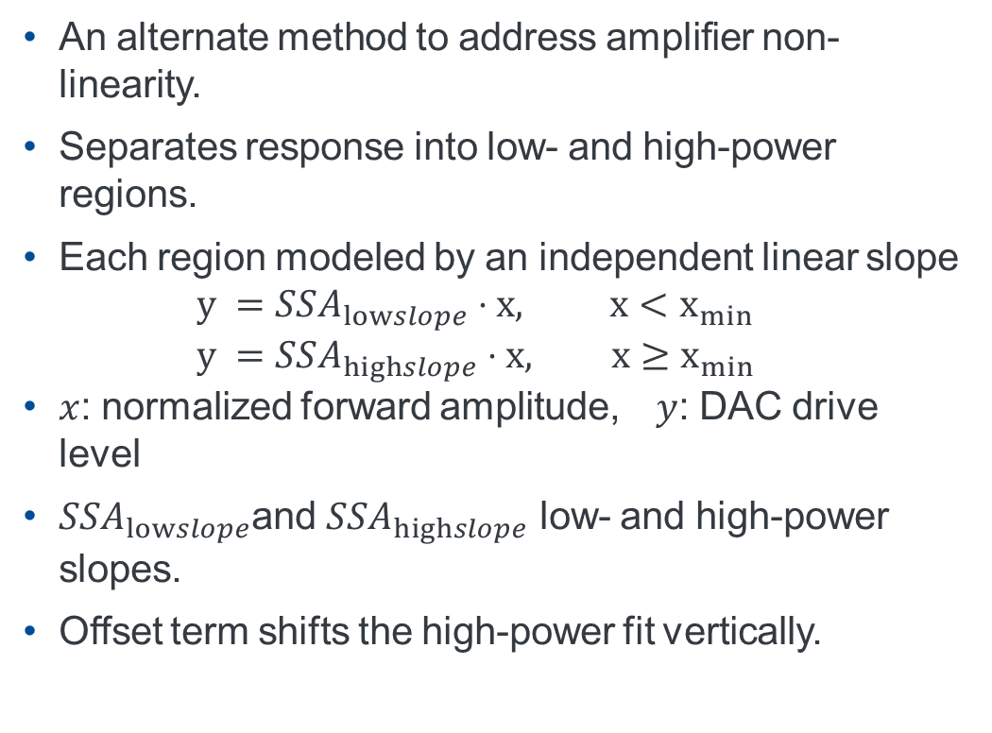
Piecewise Linear Model: Concept
An alternate method to address amplifier non-linearity.
Separates response into low- and high-power regions.
Each region modeled by an independent linear slope $y =SSA_{lowslope}⋅x, x<x_{min}$ $y =SSA_{highslope}⋅x, x≥x_{min}$
$x$: normalized forward amplitude, $y$: DAC drive level
$SSA_{lowslope}$and $SSA_{highslope}$ low- and high-power slopes.
Offset term shifts the high-power fit vertically.

Slide 18
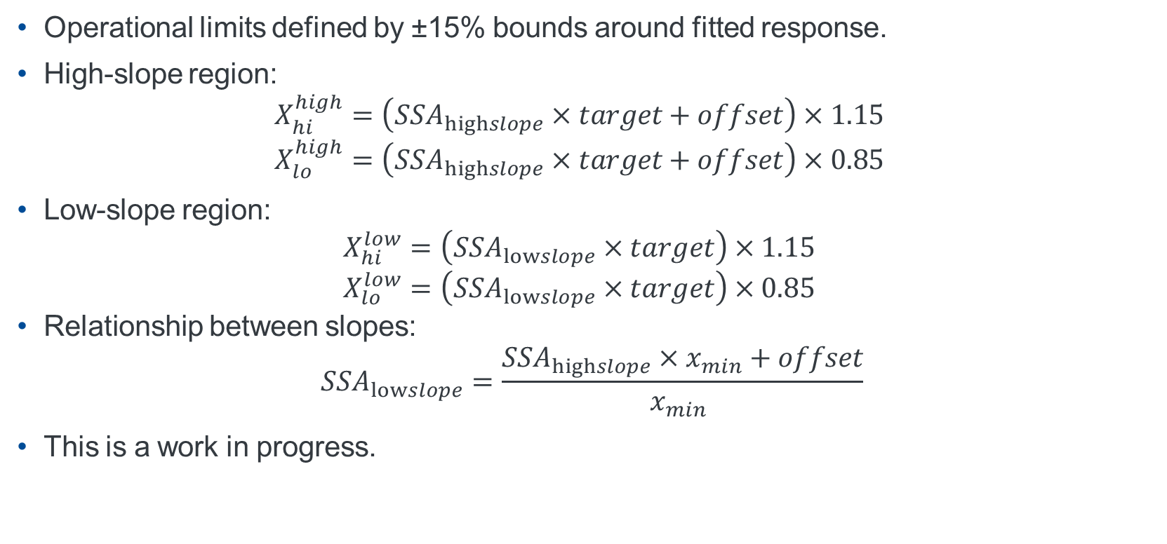
Piecewise Linear Model: Limit Definitions
Operational limits defined by ±15% bounds around fitted response.
High-slope region: $X_{hi}^{high}=\left(SSA_{highslope}×target+offset\right)×1.15$ $X_{lo}^{high}=\left(SSA_{highslope}×target+offset\right)×0.85$
Low-slope region: $X_{hi}^{low}=\left(SSA_{lowslope}×target\right)×1.15$ $X_{lo}^{low}=\left(SSA_{lowslope}×target\right)×0.85$
Relationship between slopes: $SSA_{lowslope}=\frac{SSA_{highslope}×x_{min}+offset}{x_{min} }$
This is a work in progress.

Slide 19
Conclusion
Observed SSA non-linearity with the 32kW amplifier at the PIP-II HB650 Test Stand.
Addressed it using an affine fit calibration that includes both slope and offset.
This allowed the SSA calibration to complete successfully and allow operation of the cavity in all SEL modes.
Corrected limits ensures that DAC drive commands produce the intended cavity amplitude across all SEL modes.
An alternate method of calculating the limits, Piecewise Linear Model, is proposed and still in the testing stage.

